Slide 1
Informed consent

Slide 2
What is informed consent?
Informed consent is the process for communicating information about the study to potential participants.
The process starts when the initial contact is made with potential Unannounced Standardised Patients (USPs).
The goal of the process is to ensure that they have the necessary information to make a decision about participating in a Q.REC project.
Respect is at the heart of informed consent

Slide 3
What is the process?
The process for obtaining participants' informed consent must follow local legal requirements and incorporate local cultural standards.
Study personnel will be responsible for communicating about the study, the benefits, and the risks, to potential participants.
Informed consent involves explaining to the potential participant about all of the study-related activities and to ask for that person's consent to be included in the study.

Slide 4
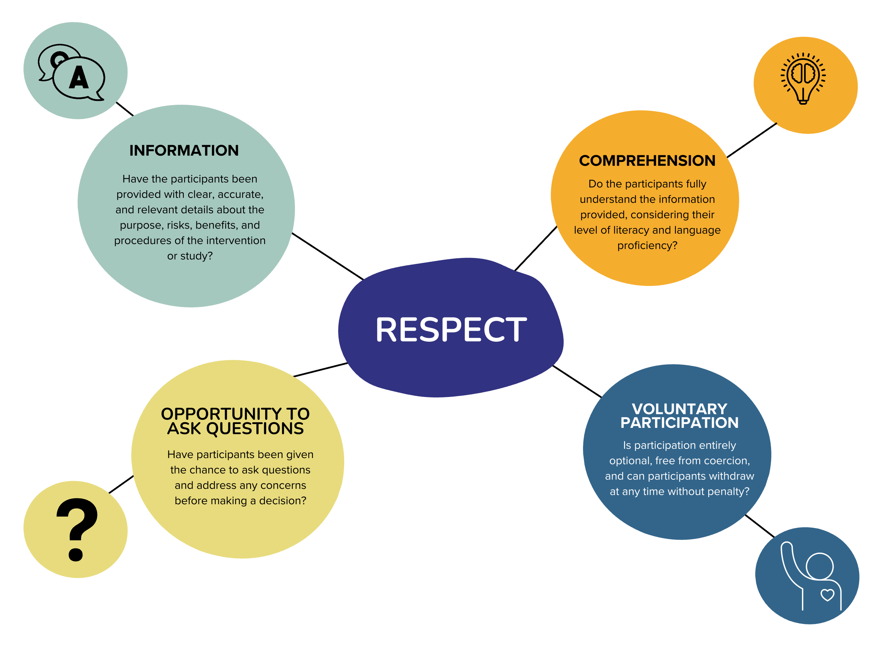
Key elements of informed consent

Slide 5
Participant consent ensures individuals are provided with clear information, fully understand it, can ask questions, and can voluntarily decide to participate without coercion

Slide 6
Study participants need to know:
✔️ Study Purpose and Procedures: Clear explanation of the study's goals and what participation involves.
✔️ Duration: How long the study or participant's involvement will last.
✔️ Participant Role: Specific expectations and responsibilities of participants.
✔️ Risks and Benefits: Potential advantages and possible risks of participating.
✔️ Costs and Compensation: Any financial costs or compensation provided.

Slide 7
Study participants need to know:
✔️ Data Usage and Storage: Details on how data will be used, stored, and shared, including duration.
✔️ Privacy and Confidentiality: Assurance of how personal details will be protected.
✔️ Study-Related Injury or Issue: Procedures for addressing any injuries or concerns arising from participation.
✔️ Freedom to Ask Questions: Encouragement to seek clarification at any stage.
✔️ Voluntary Participation: Confirmation that participation is optional and can be withdrawn without explanation.

Slide 8
What to avoid?
Coercion: Study personnel MUST NOT use coercion or undue influence when trying to consent individuals to research studies.
Rushing: Potential participants need sufficient time/privacy to consider whether they are happy to participate.

Slide 9
Unique aspects of Q.REC Studies
The Q.REC study is unique as the Unannounced Standardised Patients (USPs) are both the data collectors and the participants.
USPs need to be fully informed of their rights as participants, but also understand they have a role as a data collector.
Optical stores are also ‘participants’

Slide 10
Optical stores are also ‘participants’
An opt-out approach is typically used because explicit consent is not practical. If optical services are aware that they are being observed, then this is likely to induce optical staff to modify their behaviour.
Optical services will be provided with a consent form at least one month prior to the start of data collection.
If they choose to participate, then no further action is needed (consent assumed).
If they chose to not participate and opt-out, then they will be asked to contact the researchers.

